Slide 1


Budgeting for Uni

Slide 2


In this talk..
Student Finance re-cap
Uni living costs
How to budget
Student bank accounts
My Top 5 Budgeting Tips for Uni

Slide 3



Student Finance re-cap
Tuition fee and maintenance loan
Student Finance Calculator
Student Finance Application (deadline Fri 20 May 22)
Repaying
Student Finance Calculator

Slide 4





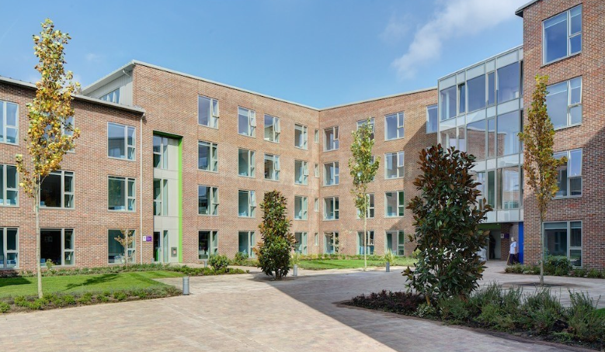










Uni living costs

Slide 5
How to budget
Identify your monthly budget
 | Student Loan | Work | Allowance | Total monthly budget
September | £452 | £570 | £50 | £1,072
October | £452 | £570 | £50 | £1,072
November | £452 | £570 | £50 | £1,072
December (home)* | £452 | £570 | £50 | £1,072
January (home)* | £452 | £570 | £50 | £1,072
February | £452 | £570 | £50 | £1,072
March | £452 | £570 | £50 | £1,072
April | £452 | £570 | £50 | £1,072
May | £452 | £570 | £50 | £1,072
June | £452 | £570 | £50 | £1,072
July (home)
August (home)
*December and January you pay rent on your student accommodation
Total student loan (per year): £4,524 £4,524/10 = £452 PM Monthly work income £142.50 X 4 = £570 PM 15 hours per week £9.50 (National Living Wage) Parents allowance £500/10 = £50 PM

Slide 6


How to budget
Identify your monthly outgoings
Monthly budget | £1,072
Rent | £516.90
Food | £160
Phone | £20
Gym | £20
Travel | £40
Toiletries/Household | £20
Socialising | £100
Subscriptions | £15
Clothing | £80
Emergency pot | £50
Uni books/equipment | £50
TOTAL | £1,071.90

Slide 7






Student Bank Accounts

Slide 8





Useful links
My Top Tip:
Do a weekly meal plan so you don’t waste food and money

Slide 9
Thanks for listening
Any Questions?

